Slide 1
Spider Robot (Scouting Robot)
Shubham Jangle
Shubham Dehrgave Soumya Jyoti Mondal

Slide 2
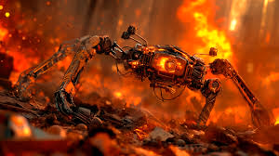
Motivation
Why Build a Spider Robot?
In natural disasters like earthquakes or gas leaks, rescue areas become inaccessible to wheeled robots.
Spiders inspire biomimetic design for their flexibility and multi-leg control.
Our robot is intended for hazardous terrain surveillance.

Slide 3
Objective and Benefits
Project Objective
To create a mobile, legged robot capable of navigating cluttered environments and capturing live surveillance data.
Benefits
Enhanced mobility compared to wheeled/tracked robots.
Surveillance capability in cluttered and hazardous environments.
Modular design that supports extensions like obstacle detection and autonomous navigation

Slide 4
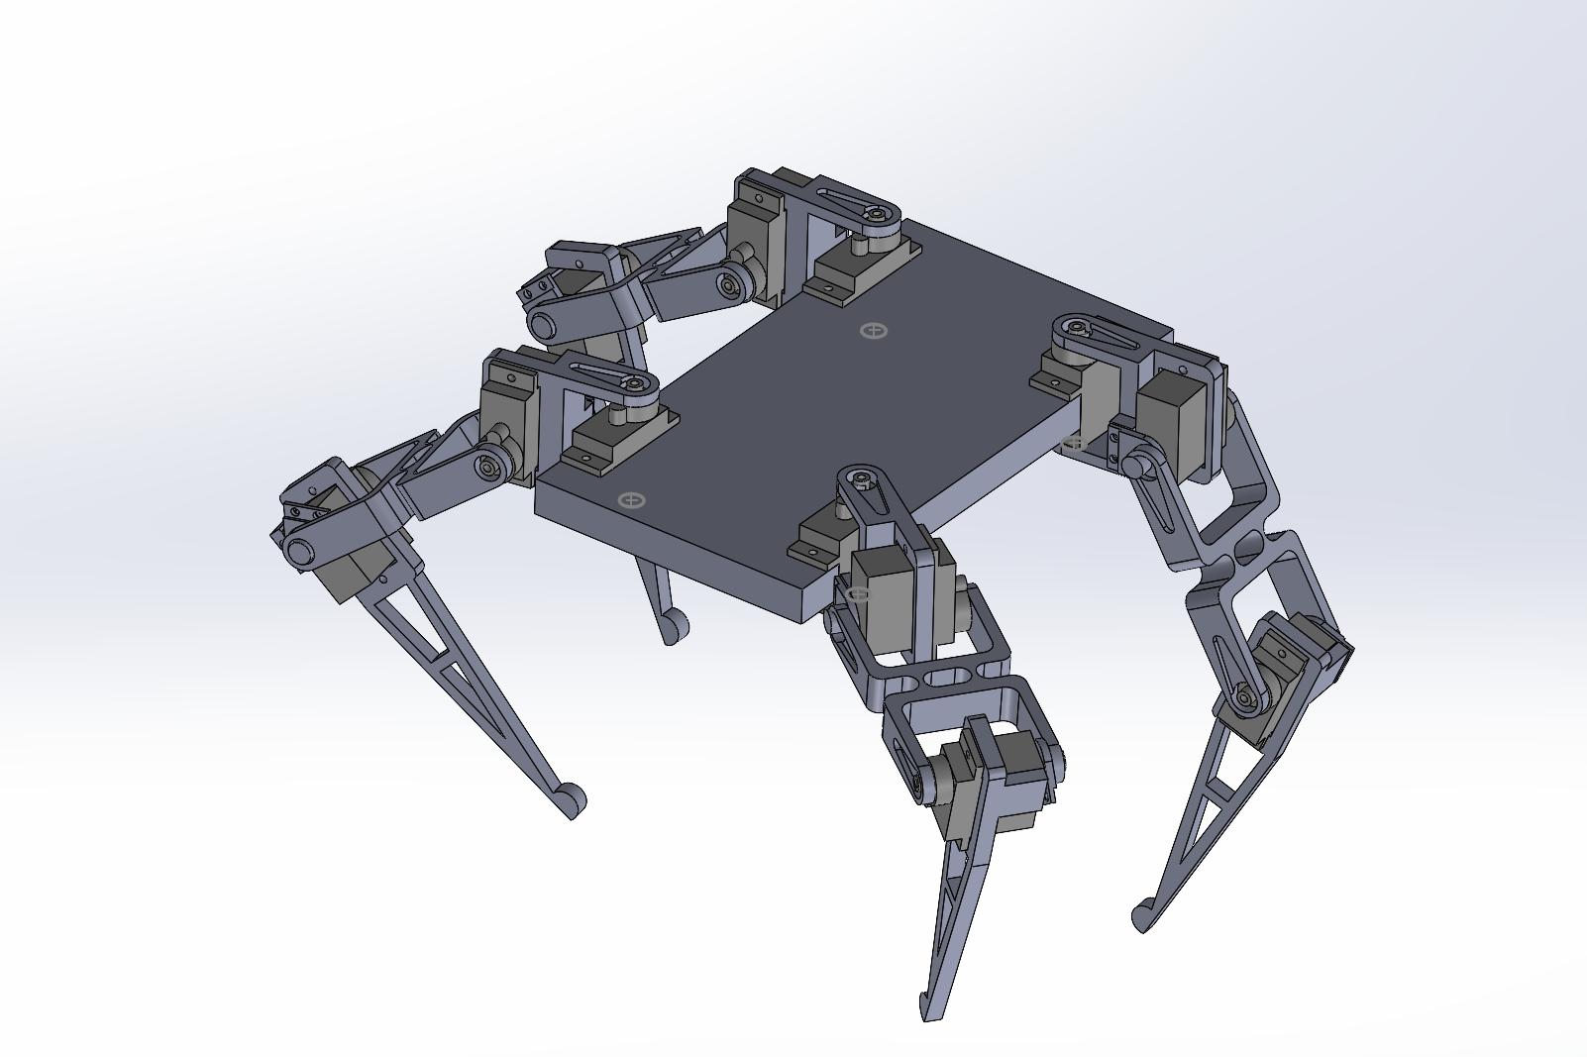
Mechanical Design
Robot Structure
The robot has 4 legs, each with 3 degrees of freedom (DOF): hip, upper leg, and lower leg.
The mechanical structure was designed in SolidWorks, optimized for balance and range of motion.
The chassis and leg parts were fabricated using 3D printing (PLA material) for lightweight structure.

Slide 5
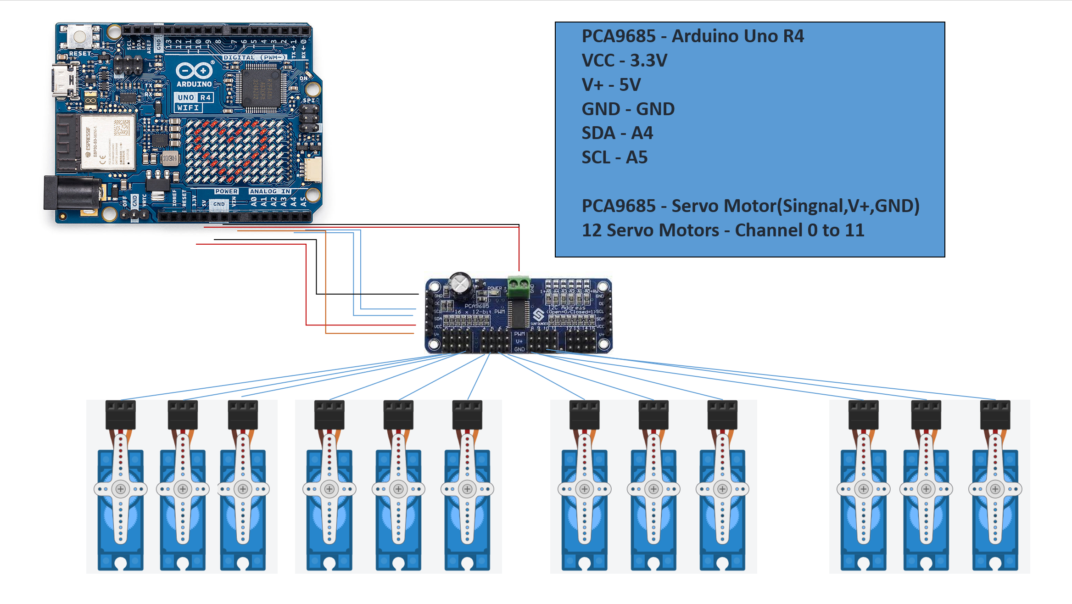
Electronics and Wiring
Electronics and Control System:
Component | Purpose
Arduino UNO R4 WiFi | Main controller
PCA9685 | Servo PWM control (16-channel)
SG90 | Hobby servos for leg movement
5V Power | External regulated supply
ESP32-CAM/Webcam | Video surveillance

Slide 6
Software & GUI
Software Development Milestones:
GUI-based servo controller built using Python Tkinter
Real-time pose adjustment and JSON-based pose saving/loading
Implementation of a tripod gait locomotion algorithm
Integration of custom pose sequence player to demonstrate complex movements

Slide 7
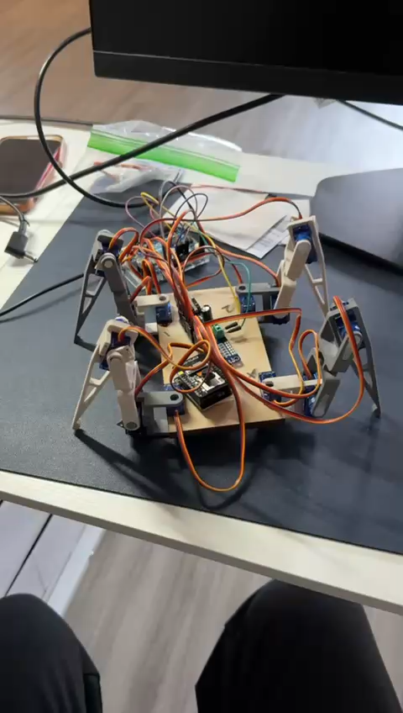
Functional Goal and Testing Achievements
Defined Functional Goal:
To create a walking robot capable of:
Remote-controlled gaited movement.
Playing saved walking sequences.
Live video streaming for surveillance.
Climb or avoid obstacle.

Slide 8
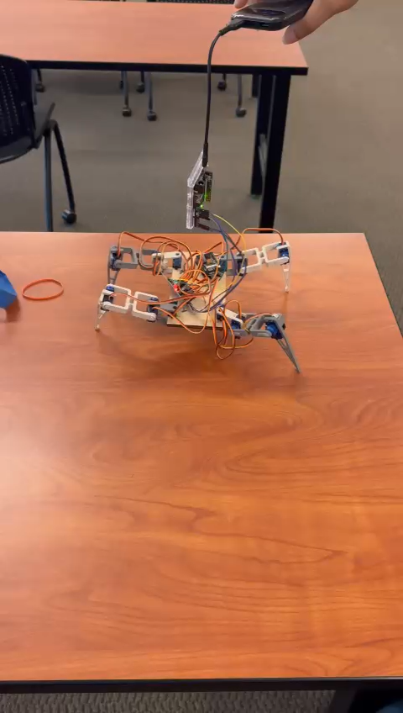
Testing Achievements
Testing Achievements:
Successfully assembled a functional walking spider robot
GUI-based control for each leg group
Pose sequence executes through 5 custom JSON files (start.json to 5.json)
Real-time WiFi communication established between Python GUI and Arduino
Robot is capable of walking, though the gait still needs refinement for smoother and more reliable locomotion

Slide 9
Quantitative Results
Performance Metrics
Stride Calculation:
Leg length ≈ 15.5 cm
Swing angle = ±20°
Step length = 2 × 10 × sin(20°) ≈ 10.60 cm
Walking Speed:
Cycle time ≈ 0.8s
Speed = 10.60 cm / 0.8s = 13.25 cm/s
Power Usage:
Current per servo ≈ 250 mA
6 active servos: 1.5 A
Power = 5V × 1.5A = 7.5W

Slide 10
Future Work
Next Steps
Integrate ultrasonic sensor for obstacle detection (avoidance or climbing logic)
Add gyroscope and IMU for better stability and terrain adaptation
Incorporate autonomous navigation using A* or SLAM
Improve power efficiency with smarter gait transitions
Implement camera-based object/person detection

Slide 11
Limitations
Current Constraints
Servo torque too low for climbing
No feedback loop (open-loop system)
Battery heating over time
Predefined gait only — no adaptive terrain sensing

Slide 12
Conclusions
Summary
A functional 12-DOF spider robot was successfully designed, built, and demonstrated.
The robot can execute saved pose sequences and stream video over WiFi.
The legged design allows traversal over uneven terrain unsuitable for wheeled robots.
GUI and pose system enables easy extension and future testing

Slide 13
Thank YOU

